Slide 3
Notes:
Quartile Distribution of pages : 118, 359, 487, 607, 1328

Slide 4
Notes:
121 policy video views/ 145 certified currently 83%

Slide 5
Notes:
Not missed:
Tricky Materials
Banned Materials
Clamps/Vises
Handling Laser Cutter Fires
Hot Glue Gun
Orientation Quiz
Soldering Iron
Utility Knife/Scissors
Scraper Blade/Knife

Slide 6
Notes:
Look at Revision of Hammer Quiz

Slide 7
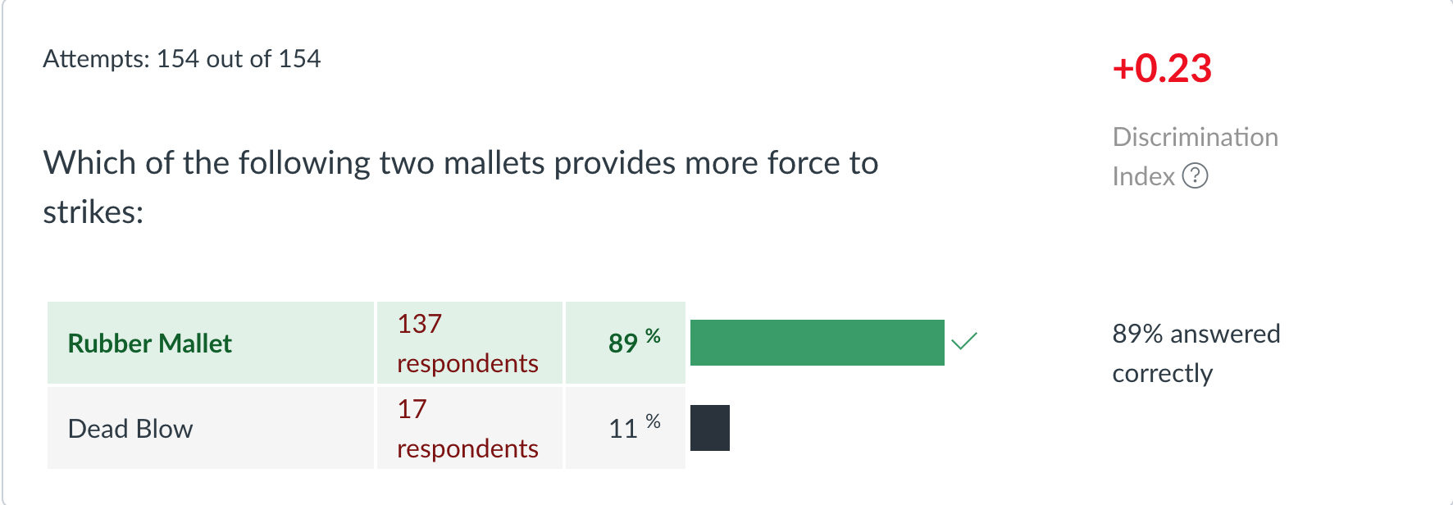
Quiz Revision
Notes:
Just deleted better for precision work

Slide 8
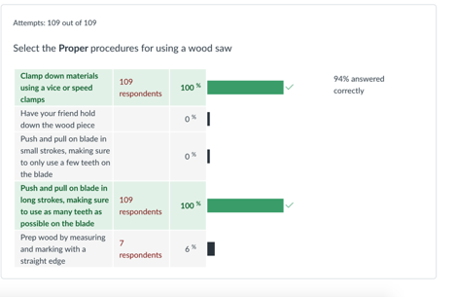
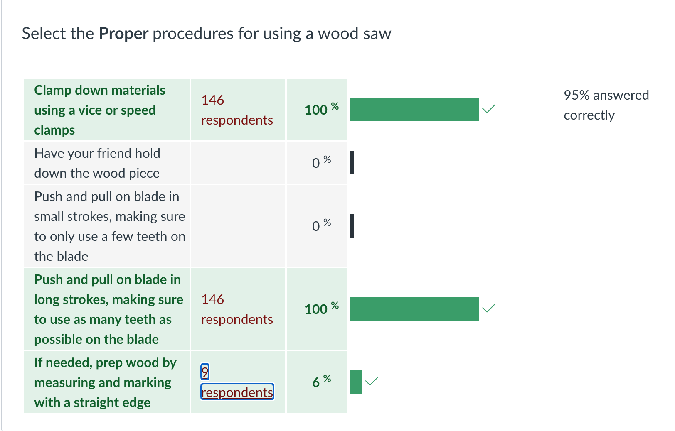
Quiz Revision

Slide 9
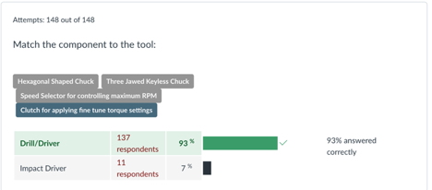
Revision 7
https://iu.instructure.com/courses/1767970/pages/revision-7

Slide 10
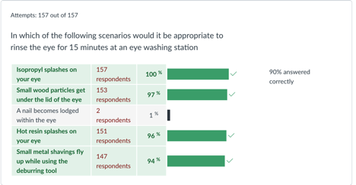
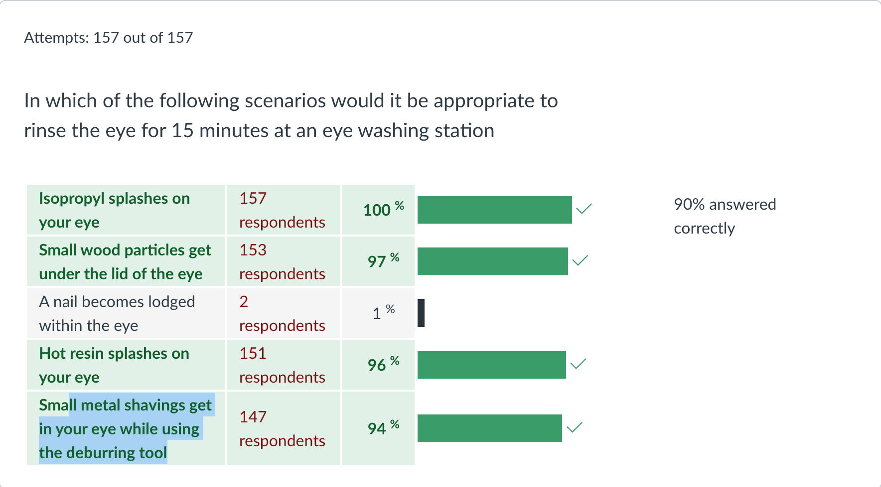
Revision 8 + Clarifying Answer

Slide 14
Notes:
Really just need Eyes, Ears, Shoes
Wish to stay connected to EHS PPE

Slide 19
Laser Cutter Material Types
Two Scenarios for Cellulose Based Fires
Three Scenarios for Textile Fires
Acrylic Fires
Polymer Fires
Do Actually Have the Scripts
Who is the intended audience? Techs or People trying to become certified?
What Modality? Emergency Response Guide? Magical Realism?
Notes:
Material is cratered or bubbling--
Need acknowledgement
Build for Techs,instructors, AIs
Something about adobe illustrator

